Slide 1

MindTrail SG

Slide 2

Purpose
From family concern to GP-ready evidence
Gamified cognitive check-ins for older Singaporeans
Not a diagnosis — a case-finding companion

Slide 3
The gap
Families notice changes too late
Forgetfulness is often dismissed as ageing
Caregivers lack structured evidence
GP visits need clearer context

Slide 4
Our insight
Dementia does not appear as one symptom
It shows through memory, speech, drawing, planning, and daily behaviour
Games can capture “how” a task is done, not just right/wrong

Slide 5
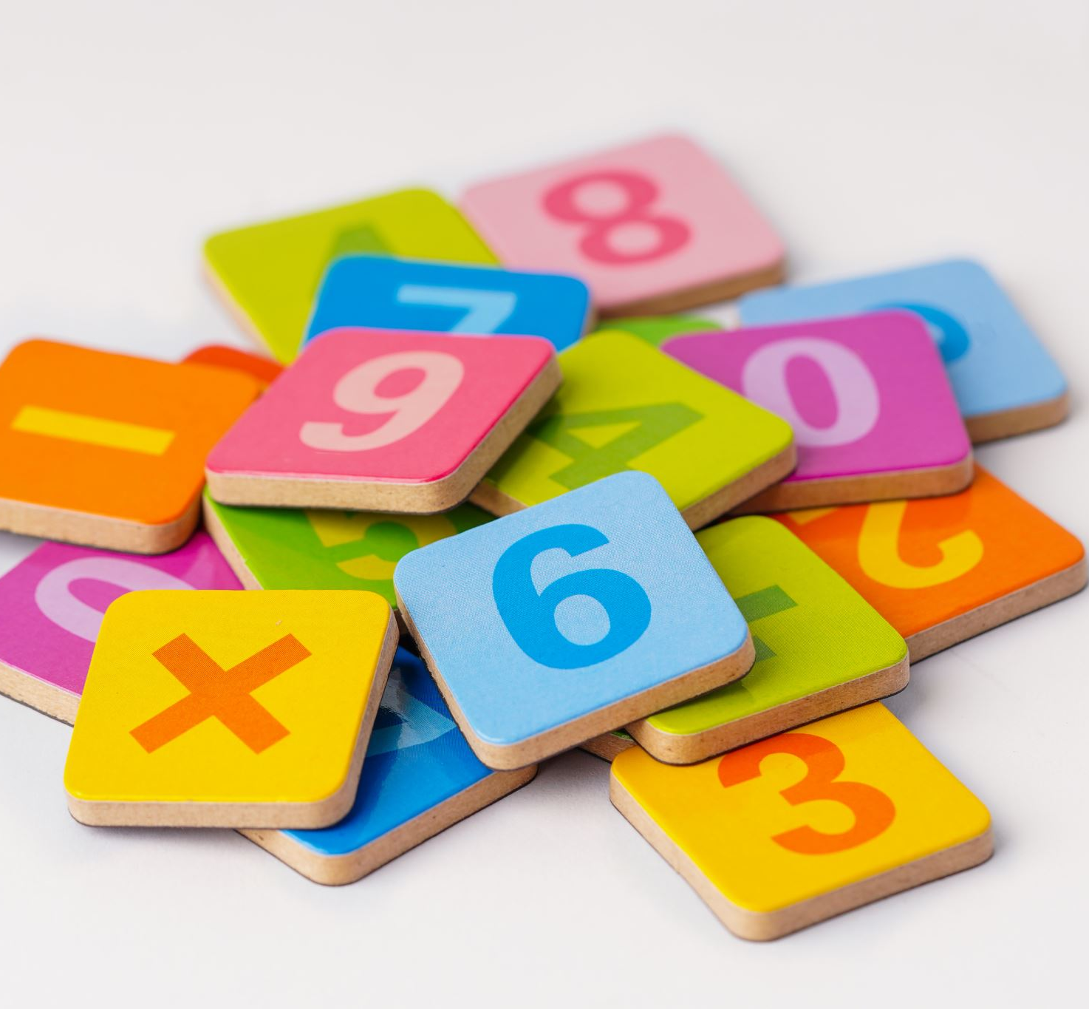
The solution
MindTrail SG runs 3 familiar cognitive mini-tasks
Adds caregiver observations
Flags possible cognitive-domain signals
Generates a GP/caregiver report

Slide 6
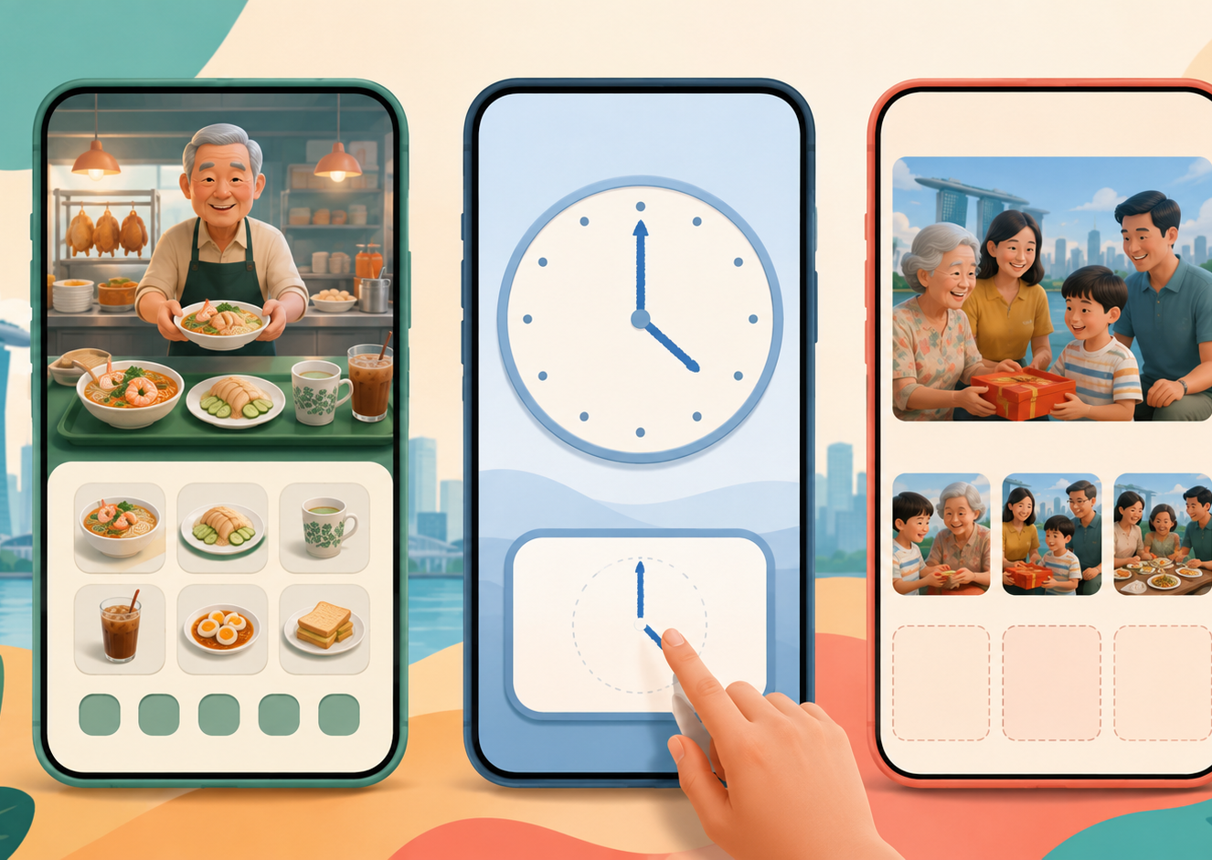
Mini-games
Hawker Memory: recall local food orders
Clock Drawing: draw a clock to a given time
Picture Story: describe a personalised happy-memory image Each maps to memory, visuospatial, speech, and language signals

Slide 7
What Makes Us Different
Not another dementia game
Singapore-localised tasks
Caregiver-linked observations
Longitudinal tracking
GP-ready handoff

Slide 8
How It Works
React Native mobile app
FastAPI backend
Voice + drawing telemetry
Dementia tested speech pipeline
Rule-based domain scoring for MVP

Slide 9

Impact
Earlier awareness
Less fear and stigma
Better caregiver conversations
Clearer GP follow-up
A practical bridge from concern to care

